Slide 1
Search Technology – Group 2
sergeyj@ifi.uio.no

Slide 2
Agenda
First session
My favourite extension for VS Code
First look at assignment C
Recap of efficient scoring
Book of the week
Second session
Working independently

Slide 3
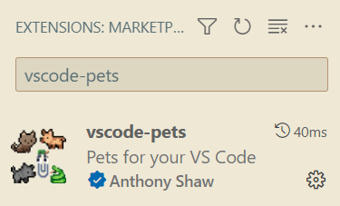
VS Code extension
vscode-pets
Pets in your editor

Slide 4
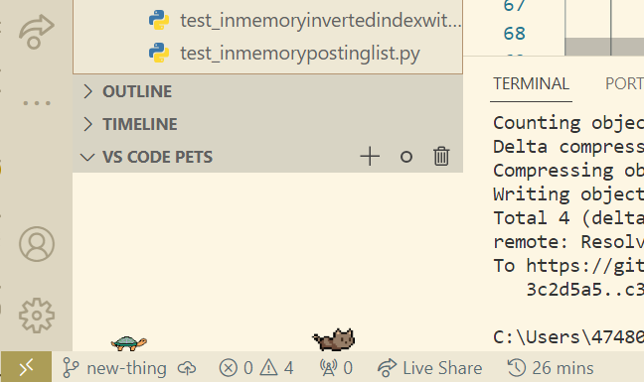
VS Code extension
vscode-pets
Reside in the bottom left part

Slide 5
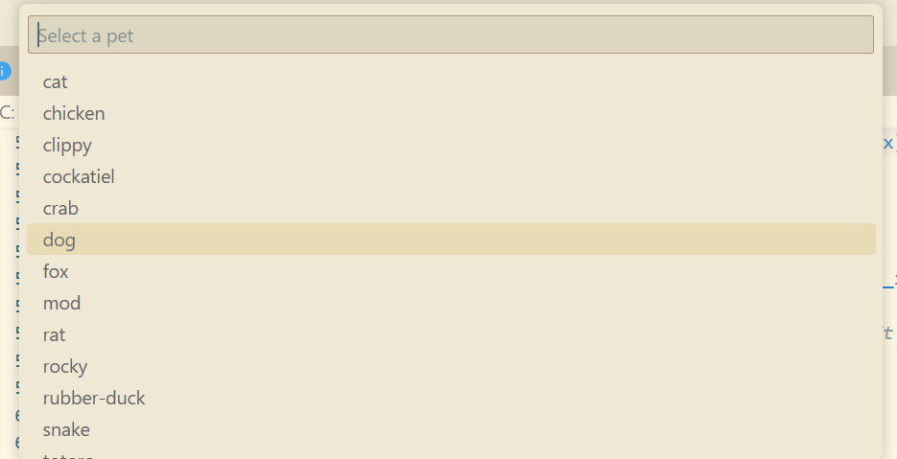
VS Code extension
vscode-pets
Can add new ones

Slide 6
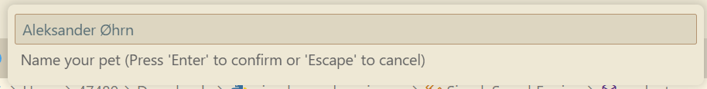
VS Code extension
vscode-pets
And give them names!

Slide 7
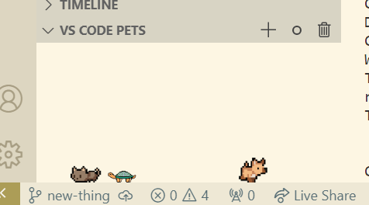
VS Code extension
vscode-pets

Slide 8
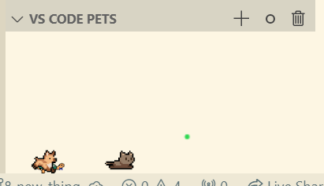
VS Code extension
vscode-pets
Can also throw them a ball!

Slide 9
Agenda
First session
My favourite extension for VS Code
First look at assignment C
Recap of efficient scoring
Book of the week
Second session
Working independently

Slide 10
Assignment C
simplesearchengine.py
Tips
Try to draw the process before programming
Read the comment under the function signature
Notes:
It’s nice to have someone holding you accountable, and that you can bother with questions, because you’re working towards the same goal!

Slide 11
Assignment C
def __init__(self, corpus, inverted_index):
self.__corpus = corpus
self.__inverted_index = inverted_index
Notes:
It’s nice to have someone holding you accountable, and that you can bother with questions, because you’re working towards the same goal!

Slide 12
Assignment C
def evaluate(self, query: str, options: dict, ranker: Ranker)
-> Iterator[Dict[str, Any]]
Notes:
It’s nice to have someone holding you accountable, and that you can bother with questions, because you’re working towards the same goal!

Slide 13
Assignment C
def test_mesh_corpus(self):
query: "polluTION Water"
options: {"match_threshold": 0.1, "hit_count": 10}
Notes:
It’s nice to have someone holding you accountable, and that you can bother with questions, because you’re working towards the same goal!

Slide 14
Assignment C
Part 1
Evaluate the query, doing N-out-of-M ranked retrieval
It’s enough to contain N of M terms to be a match
NB! M are unique terms. Query "Hello hello hello" has M=1
Notes:
It’s nice to have someone holding you accountable, and that you can bother with questions, because you’re working towards the same goal!

Slide 15
Assignment C
Part 2
When all documents are found, rank and yield
The best document must be yielded first
Notes:
It’s nice to have someone holding you accountable, and that you can bother with questions, because you’re working towards the same goal!

Slide 16
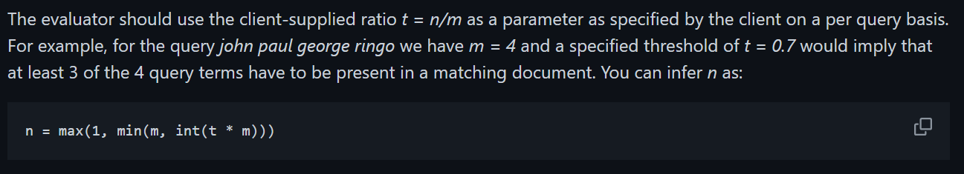
Assignment C
Notes:
It’s nice to have someone holding you accountable, and that you can bother with questions, because you’re working towards the same goal!

Slide 17
Assignment C
query_terms = self.__inverted_index.get_terms(query)
m = len(set(query_terms))
n = max(1, min(m, int(options["match_threshold"] * m)))
sieve = Sieve(options["hit_count"])
Notes:
It’s nice to have someone holding you accountable, and that you can bother with questions, because you’re working towards the same goal!

Slide 18
Agenda
First session
My favourite extension for VS Code
First look at assignment C
Recap of efficient scoring
Book of the week
Second session
Working independently

Slide 19
Recap of efficient scoring
Safe vs. non-safe scoring
WAND scoring
Champion lists
High & low lists
Tiered indexes
Static quality scores
Impact-ordered postings
Cluster pruning
Parameters and zones

Slide 20
Efficient scoring
Problem 1
Users rarely care about all the relevant documents
Usually a few will do
We call this magic number K.

Slide 21
Efficient scoring
Problem 2
Computing and comparing cosines for entire corpus takes too long
Two ways to approach the problem:
Safe ranking
Non-safe ranking

Slide 22
Safe vs. non-safe scoring
Safe ranking ensures we get the K best documents
Non-safe ranking also gives us K documents, but not necessarily the K best ones!

Slide 23
WAND scoring
Safe ranking approach
Query: "informatics is fun"
Corpus: [doc 1, doc 2, doc 3, doc 4, doc 5]

Slide 24
WAND scoring
✔️ means "term occurs in document"
❌ means "term does not occur in document"
doc id | informatics | is | fun
1 | ✔️ | ✔️ | ❌
2 | ✔️ | ❌ | ✔️
3 | ❌ | ✔️ | ✔️
4 | ✔️ | ✔️ | ✔️
5 | ✔️ | ❌ | ❌

Slide 25
WAND scoring
Now we must score (document, term)-pairs
This case: term frequency

Slide 26
WAND scoring
Scoring every single pair is computationally expensive
Instead, we can give each (document, term)-pair an "upper bound"
term | upper bound
Informatics | 5
Is | 4
fun | 3

Slide 27
WAND scoring
We also have a threshold
The minimum value a document can have to be considered "good enough"
Our threshold starts at 0

Slide 28
WAND scoring
Before we start, we don’t know any values
doc id | informatics | is | fun
1 | ? | ? | ?
2 | ? | ? | ?
3 | ? | ? | ?
4 | ? | ? | ?
5 | ? | ? | ?

Slide 29
WAND scoring
We compute the value for (document 1, informatics)
doc id | informatics | is | fun
1 | 3 | ? | ?
2 | ? | ? | ?
3 | ? | ? | ?
4 | ? | ? | ?
5 | ? | ? | ?

Slide 30
WAND scoring
Rather than doing the same for (doc 1, is) and (doc 1, fun), we use the upper bound scores!
doc id | informatics | is | fun
1 | 3 | ? | ?
2 | ? | ? | ?
3 | ? | ? | ?
4 | ? | ? | ?
5 | ? | ? | ?

Slide 31
WAND scoring
(doc 1, informatics)
+ (upper bound of is)
+ (upper bound of fun)
= 10
doc id | informatics
1 | 3
term | upper bound
is | 4
fun | 3

Slide 32
WAND scoring
Since 10 > 0, we compute the cosine score for (document 1, "informatics is fun")
The result will be our new threshold

Slide 33
WAND scoring
In practice, we traverse every posting list concurrently, from lowest ID to highest
Pointers in all lists are synchronised to avoid computing values twice

Slide 34
WAND scoring
doc id | informatics | is | fun
1 | ? | ?
2 | ? |  | ?
3 |  | ? | ?
4 | ? | ? | ?
5 | ?

Slide 35
WAND scoring
doc id | informatics | is | fun
1 | 📍 | 📍
2 | ? |  | 📍
3 |  | ? | ?
4 | ? | ? | ?
5 | ?

Slide 36
WAND scoring
doc id | informatics | is | fun
1 | 📍 | 📍
2 | ? |  | 📍
3 |  | ? | ?
4 | ? | ? | ?
5 | ?

Slide 37
WAND scoring
doc id | informatics | is | fun
1 | ? | 📍
2 | 📍 |  | 📍
3 |  | ? | ?
4 | ? | ? | ?
5 | ?

Slide 38
WAND scoring
doc id | informatics | is | fun
1 | ? | 📍
2 | 📍 |  | 📍
3 |  | ? | ?
4 | ? | ? | ?
5 | ?

Slide 39
WAND scoring
doc id | informatics | is | fun
1 | ? | 📍
2 | ? |  | 📍
3 |  | ? | ?
4 | 📍 | ? | ?
5 | ?

Slide 40
Non-safe ranking
Non-safe ranking also gives us K documents, but not necessarily the K best ones!
Generic approach: Pick set of candidates A, and return K best results from A
NB! The curriculum is only the what, not the how!

Slide 41
Champion lists
Each term maps to a champion list in addition to the standard posting list
The champion list contains the R best documents from the posting list
When the user gives us a query, we can pick and rank documents from the champion list

Slide 42
Champion lists
Drawback:
The champion list must be computed at index time, so R might be less than K!

Slide 43
High & low lists
Divide the posting list into 2:
The high list contains the best documents (champion list)
The low list contains all the other documents
Upon query, return K documents from high list
If high list not big enough, pick documents from low list

Slide 44
Tiered indexes
Instead of having just high and low list, we can divide posting list into even more tiers
Upon query, start returning documents from highest list, and move downwards until we reach K

Slide 45
Static quality scores
The best documents should be relevant, but also authoritative
Example: Paper with many citations, recognised newspaper etc.

Slide 46
Static quality scores
Each document can be given an authority-score between 0 and 1
We call it g(d). This is static and global, independent of terms
Net score(q, d) = g(d) + cosine(q, d)

Slide 47
Static quality scores
Can sort postings on g(d) score instead of document id!
Ties are solved on document id
This way the most autoritative documents are picked!
Assignment D-1

Slide 48
Impact-ordered postings
We only compute the score of documents with a high enough wf_{t,d} score.
wf = weight function
tf_{t,d}
tf_{t,d}-idf_{t}.
etc.

Slide 49
Impact-ordered postings
Problem
Posting lists are now ordered "locally"
Documents have different wf-scores from term to term

Slide 50
Impact-ordered postings
Solution
Pick the N best documents from each list, take their union and score them
Pick the documents above a certain wf-score, take their union and score them

Slide 51

Cluster pruning
Given a corpus of N documents
Let $\sqrt{N}$ random documents be leaders
Attatch all other documents to their closest leader
Given query, find nearest leader and return attatched documents

Slide 52
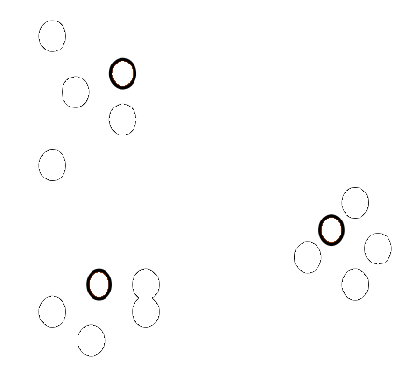
Cluster pruning
Documents floating around in vector space

Slide 53
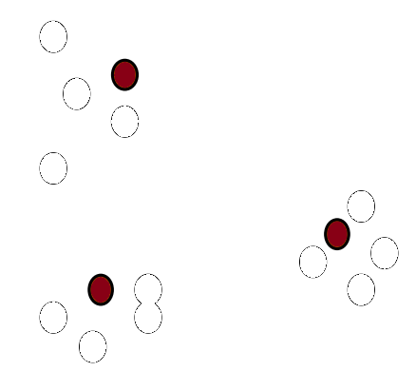
Cluster pruning
Pick random documents to be leaders

Slide 54
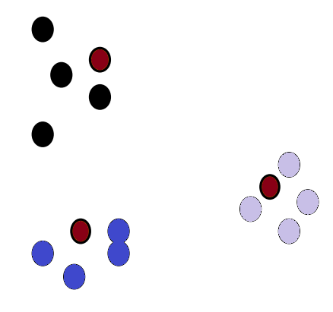
Cluster pruning
Attatch closest documents

Slide 55
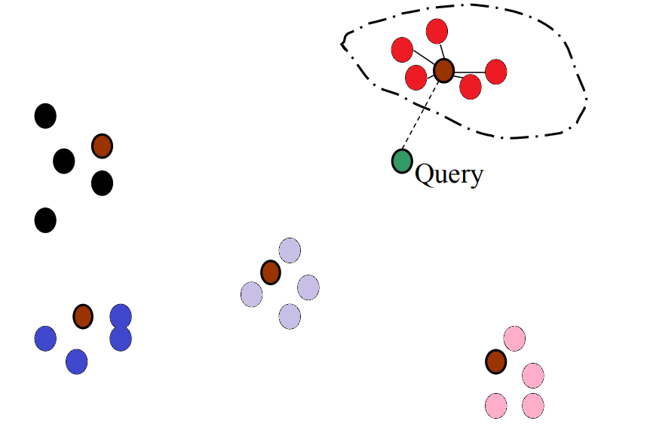
Cluster pruning
Given query, find nearest leader and return attatched documents

Slide 56
Parameters and zones
So far we’ve treated documents as a single sequence of terms
But we can also divide them into
parameters (language, author, format etc.)
zones (title, abstract, footer etc.)
Allows more precise queries and results!

Slide 57
Parameters and zones
Can include them in postings

Slide 58
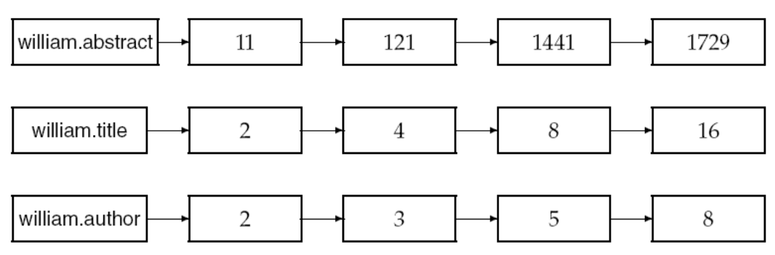
Parameters and zones
Or map individual parameters/zones to new postings

Slide 59
Agenda
First session
My favourite extension for VS Code
First look at assignment C
Recap of efficient scoring
Book of the week
Second session
Working independently

Slide 60

Book of the week
Pan
Knut Hamsun
Personal opinion
Very frustrating
Sad and funny
One of my all-time favourite books

Slide 61
Agenda
First session
My favourite extension for VS Code
First look at assignment C
Recap of efficient scoring
Book of the week
Second session
Working independently

